Slide 1
A Practical Overview of Actors in Service Fabric
Service Fabric enables you to build and operate always-on, hyper-scale services using the same technology powering Microsoft’s Cloud.

Slide 2
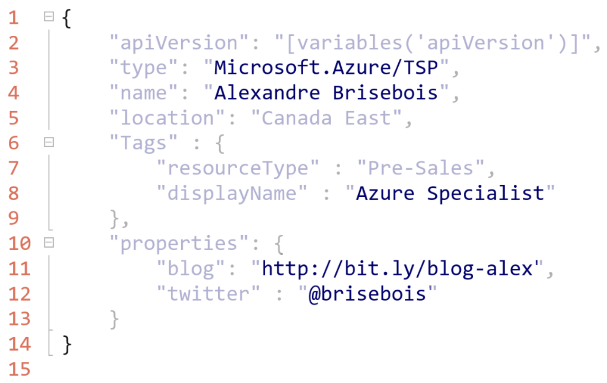
About me

Slide 3
Today we’re going to learn about
Microsoft Azure – a public cloud
Microservices – an architectural pattern
Service Fabric – a hyper-scale microservice platform
Reliable Actors – a programming model
Notes:
A Public Cloud
An Architectural Pattern
A Hyper-Scale Microservice Platform
A Programming Model

Slide 4
Live Q&A
Browse to http://bit.ly/dt-qna
API : http://liveqna.alexandrebrisebois.com/api
Demo Source: http://bit.ly/git-qna-demo

Slide 5
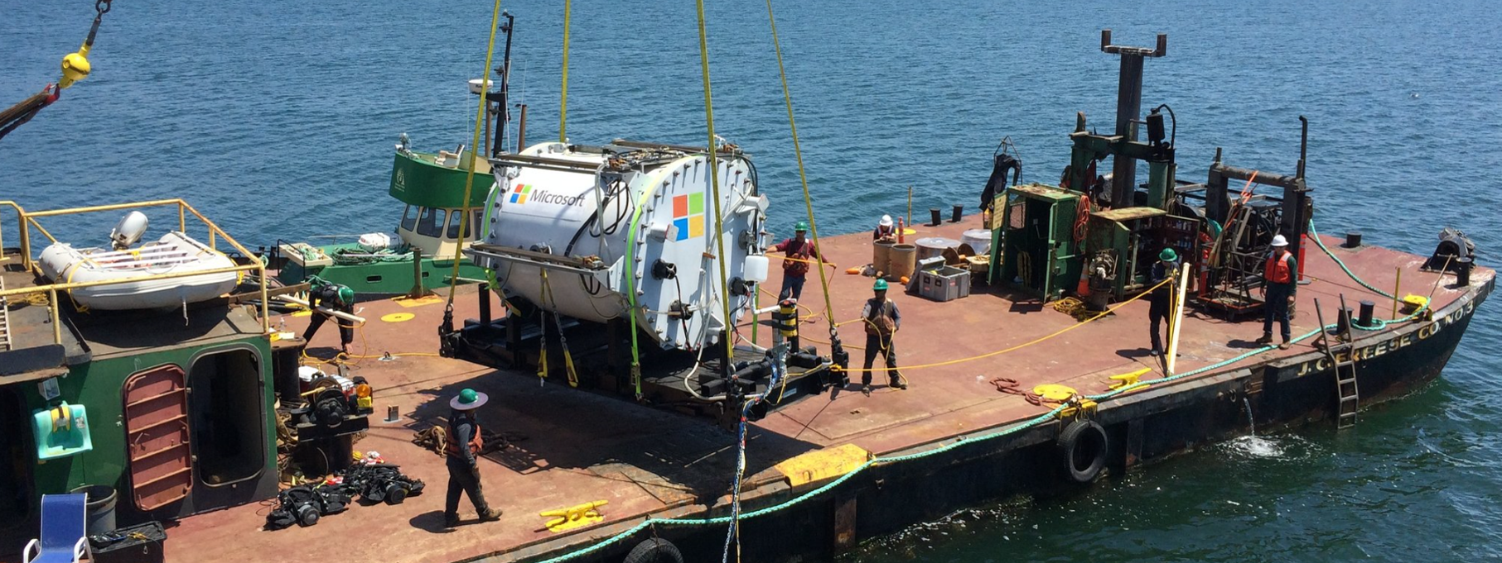
Microsoft Azure
Pushing innovation to its limits
Notes:
Have you seen this picture before?
Thinking about what’s next.
Pluggable capacity.

Slide 6
What do all of these have in common?
Azure Document DB
billions transactions/week
Skype for Business
Hybrid Ops
Azure Core Infrastructure
thousands of machines
Intune
over 1m devices
Bing Cortana
500m evals/sec
Azure SQL Database
millions of databases
Event Hubs
20bn events/day
Power BI

Slide 7
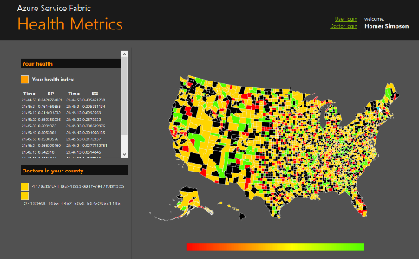

Microservices
Graph of interconnected microservices
State typically scoped to the microservice
Variety of technologies used
Remote Storage for cold data
Tiers of specific technologies
stateless presentation services
Single monolithic
database
stateless services with
separate stores
stateful services
Notes:
The answer is Microservices
Let’s start by 3-tier Monolith
Then Microservices

Slide 8
Why microservices?
Design/ Develop
Operate
Upgrade
Allows us to get closer to the business
Provides the business with agility
Small focussed teams
Reduced time-to-customer
Notes:
From a Dev’s perspective :
Simplified architecture (focused)
Build, scale, and upgrade services independently

Slide 9

Service fabric
Service Fabric enables you to build and operate always-on, hyper-scale services using the same technology powering Microsoft’s Cloud.
Notes:
Service Fabric isn’t new, it’s battle tested
Used to build Azure itself
Same bits that are running in Azure
Used to build Hyper-Scale services

Slide 10
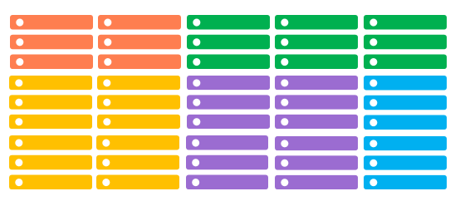
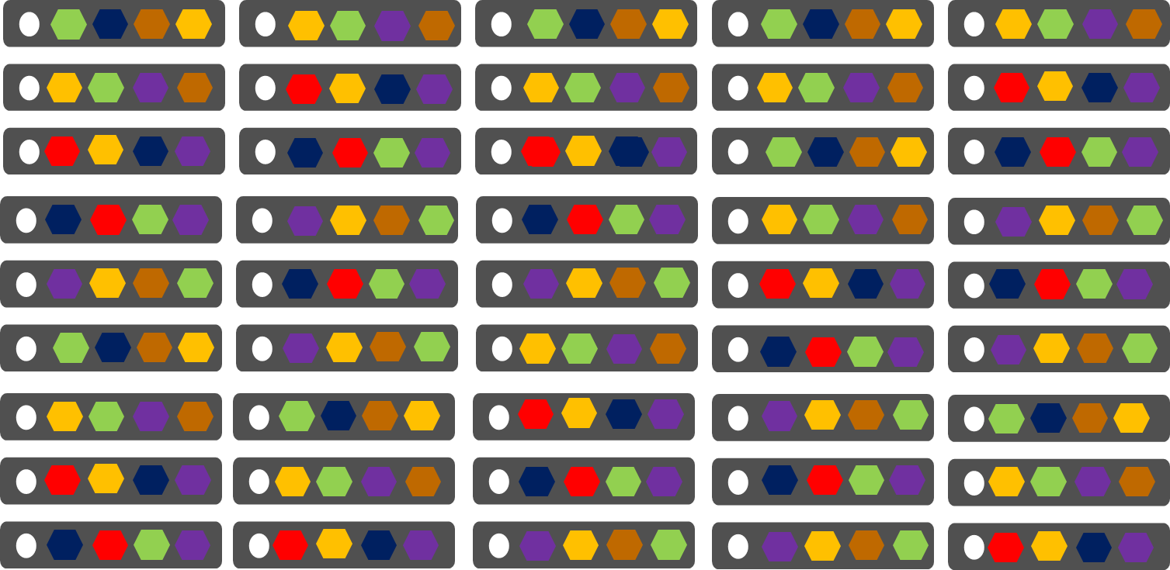
Service Fabric
Service Fabric
Conventional Services
1 instance per VM
Uneven utilization
Low density
Slow deployment & upgrade (bound to VM)
Slow scaling and failure recovery
Limited fault tolerance
Many microservices per VM
Even Utilization (by default, customizable)
High density (customizable)
Fast deployment & upgrade
Fast scaling of independent microservices
Tunable fast fault tolerance

Slide 11
Service Fabric
LifecycleMgmt
Independent Scaling
Independent Updates
Always On Availability
Resource Efficient
Stateless/
Stateful
Public Cloud
Other Clouds
Private cloud

Slide 12
Service fabric
Application Programming Models
Management
Subsystem Deployment, Upgrade and Monitoring
Communication
Subsystem Service discovery
Reliability
Subsystem Reliability, Availability, Replication, Service Orchestration
Hosting & Activation
Subsystem Application lifecycle
Testability
Subsystem Fault Inject, Test in production
Federation Federates a set of nodes to form a consistent scalable fabric
Transport Secure point-to-point communication

Slide 13
WHY Service fabric?
Scalability – support variable demand High Availability – always on Reliability – predictable outcomes Resiliency – self healing (adapts to adversity) Durability – guarantees data persistence
Notes:
Elasticity scale-in scale-out / if needed scale up and down

Slide 14
Service fabric – Programming models
Guest Executables
Bring any exe
Any language
Any programming model
Packaged as Application
Gets versioning, upgrade, monitoring, health, etc.
Reliable Services
Stateless & stateful services
Concurrent, granular state changes
Use of the Reliable Collections
Transactions across collections
Full platform integration
Reliable Actors
Stateless & Stateful actor objects
Simplified programming model
Single Threaded model
Great for scaled out compute and state
Notes:
Breifly Guest & Reliable Services
Then Actors

Slide 15
Service Fabric – Reliable Actors
Independent units of compute and state
Large number of processes executing in parallel
Communicates using asynchronous messaging
Single threaded execution
Automatically created and dehydrated as necessary

Slide 16
Service Fabric – Cattle Not Pets!
Service partitions are striped across machines in the cluster.
Replicas automatically scale out & in on cluster changes
Node 1
Node 2
Node 3
Node 4
Node 5
Node 6
S
P2
P1
S
S
S
S
P3
P4
S
S
S

Slide 17
Live QnA microservice architecture

Slide 18
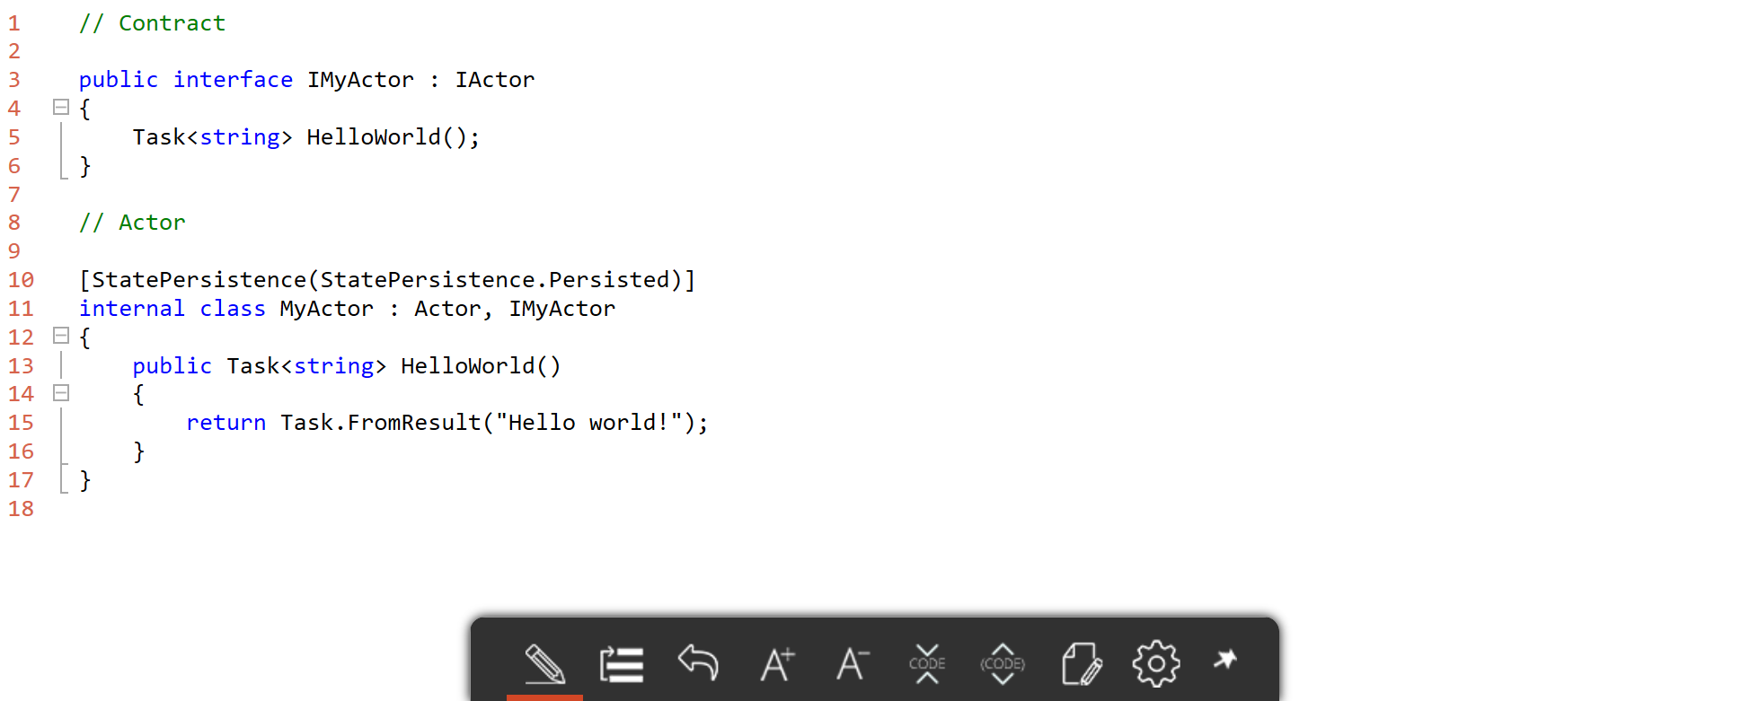
Service fabric – Actor

Slide 19
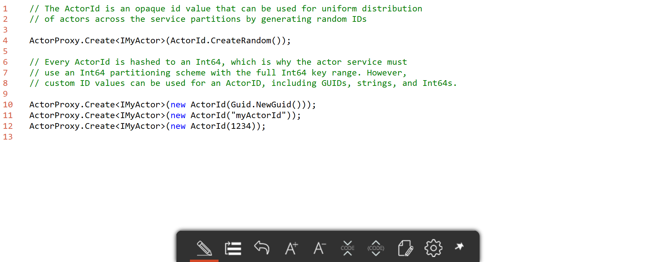
Service fabric – Actor – ID kinds

Slide 20
Service Fabric – Actor – State
Ack
Read
Value
Reads are completed at the primary
Writes are replicated to the write quorum of secondaries
Write
Ack
P
Ack
Ack
Ack
S
S
Write
Write
S
S
Write
Write

Slide 21
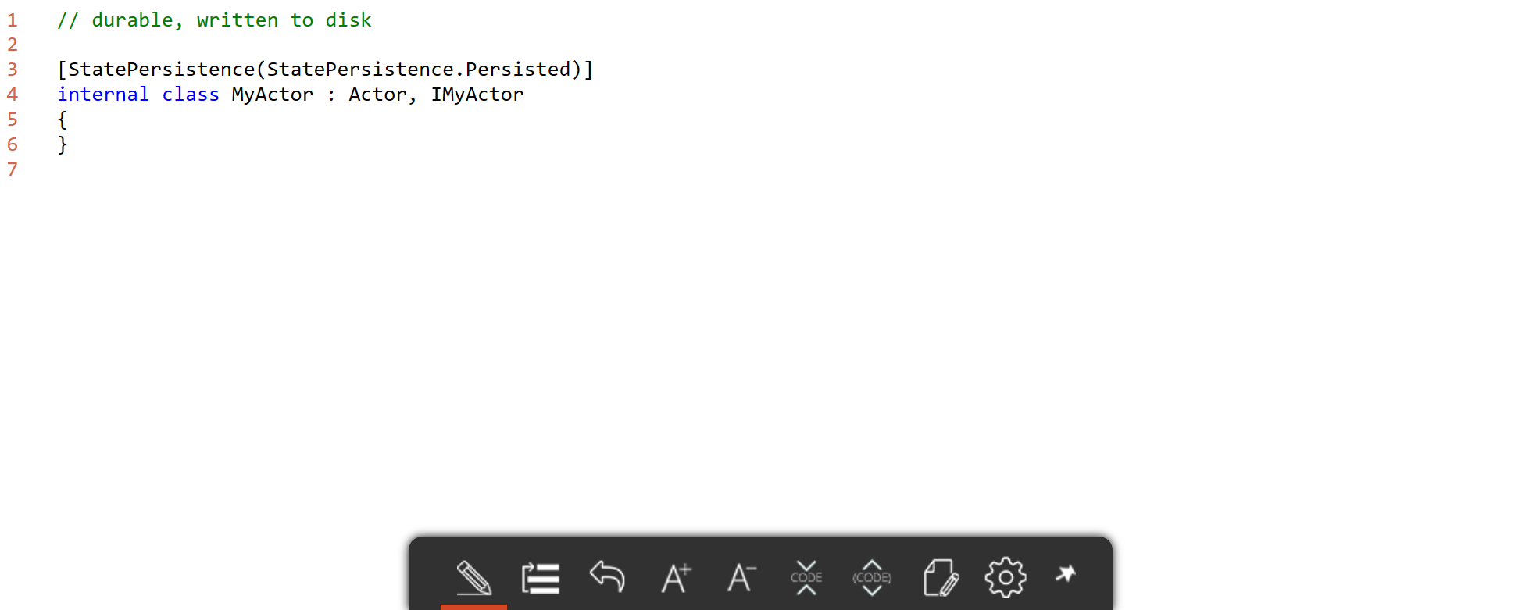
Service fabric – Actor – State

Slide 22
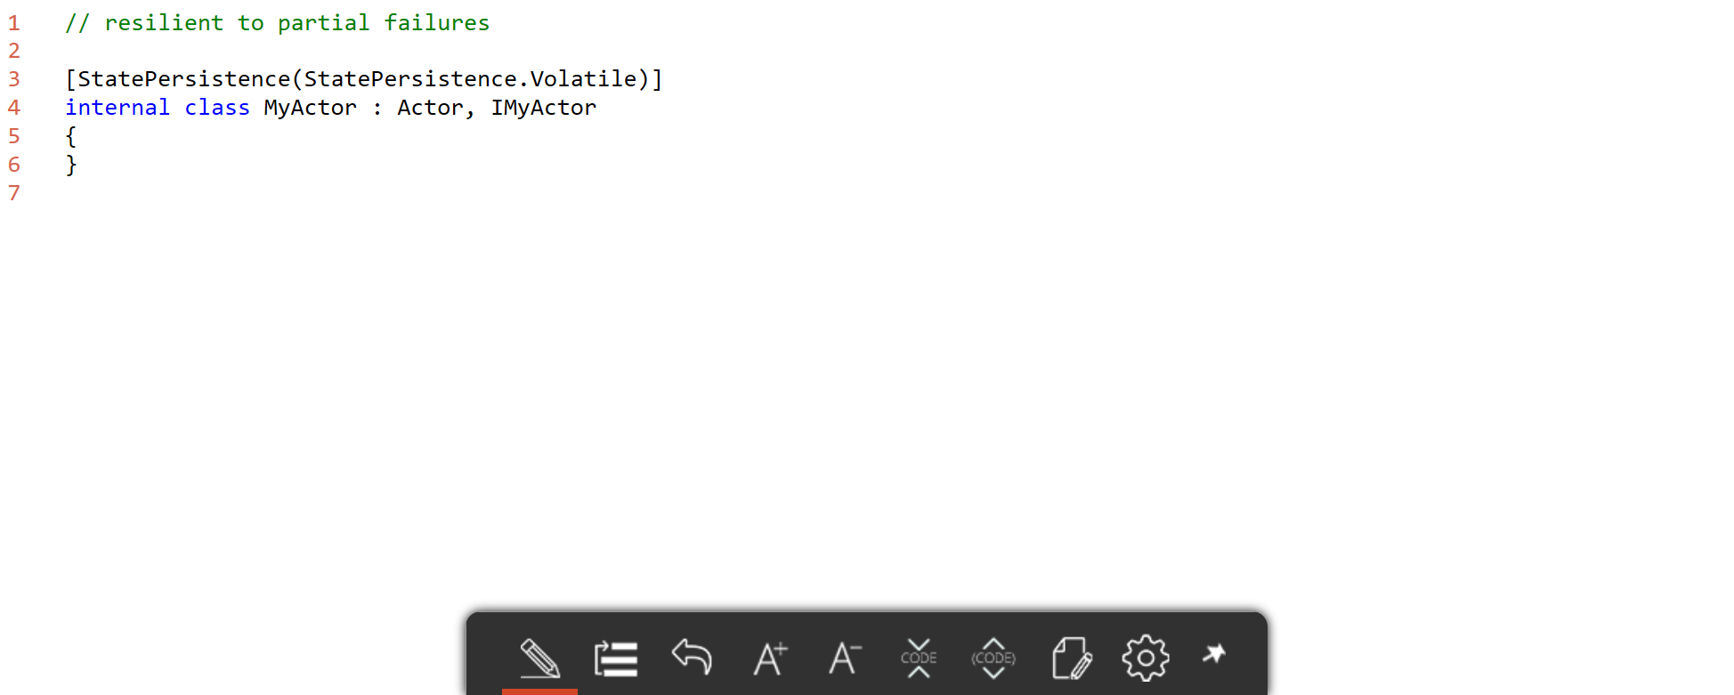
Service fabric – Actor – State

Slide 23
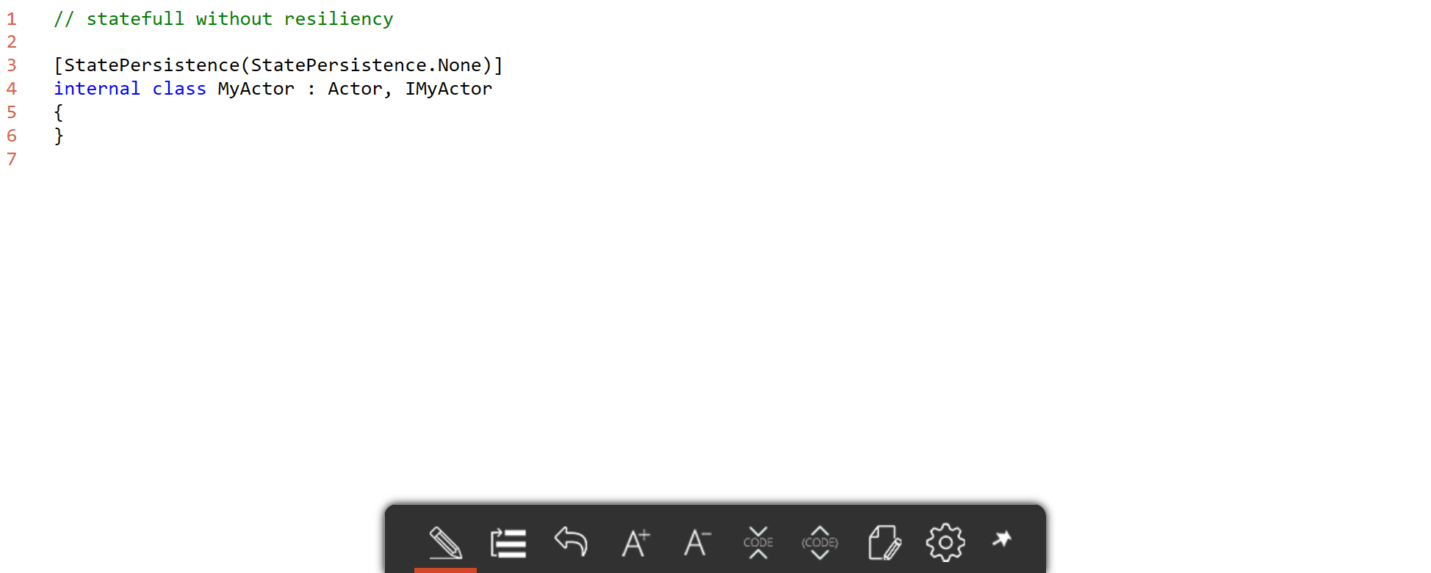
Service fabric – Actor – State

Slide 24
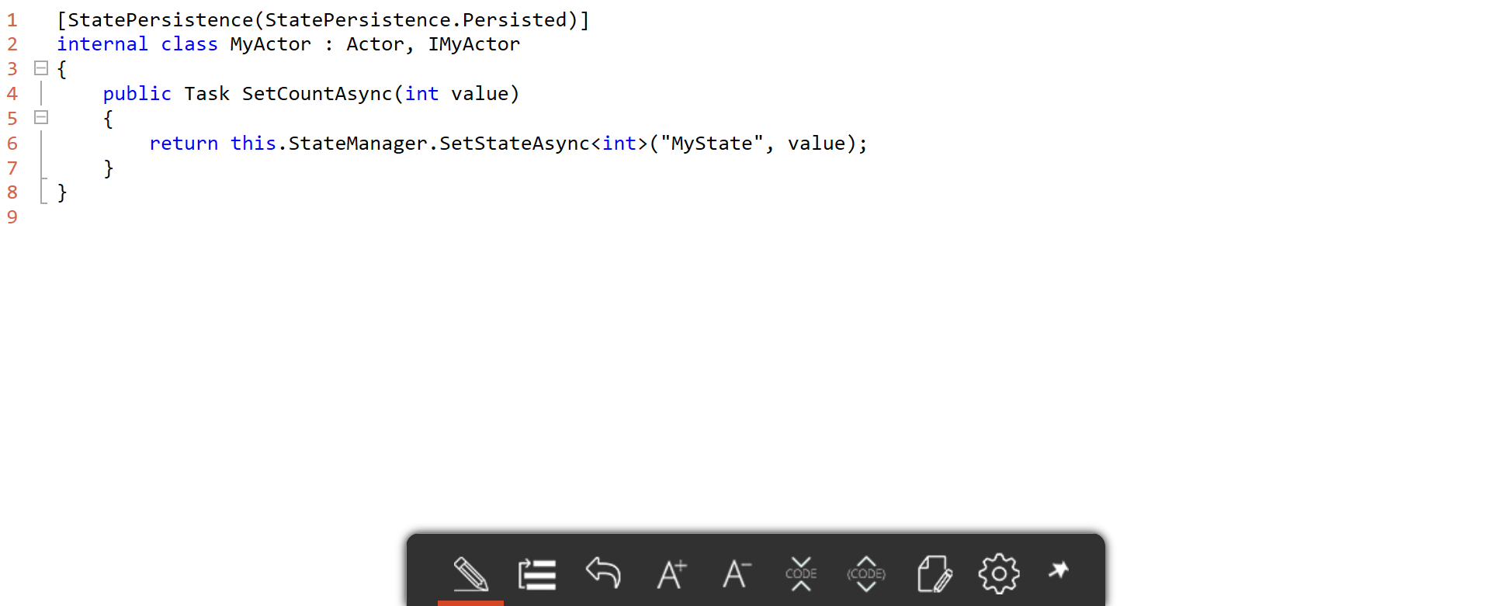
Service fabric – Actor – persisting state

Slide 25
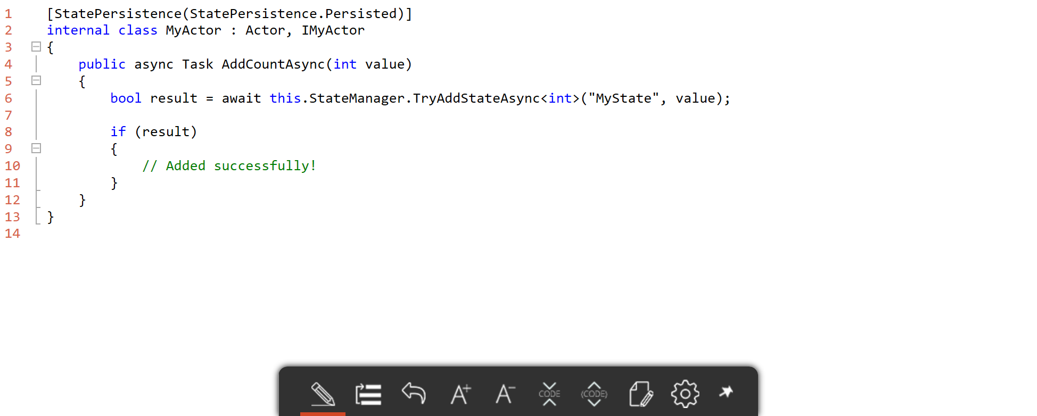
Service fabric – Actor – persisting state

Slide 26
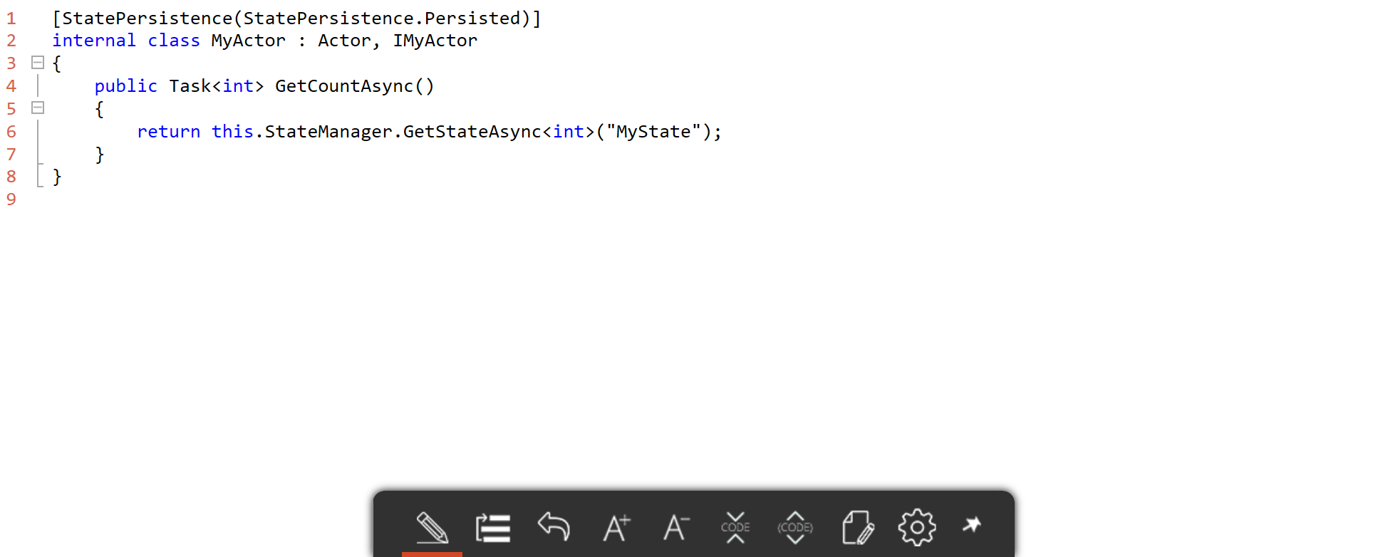
Service fabric – Actor – Reading state

Slide 27
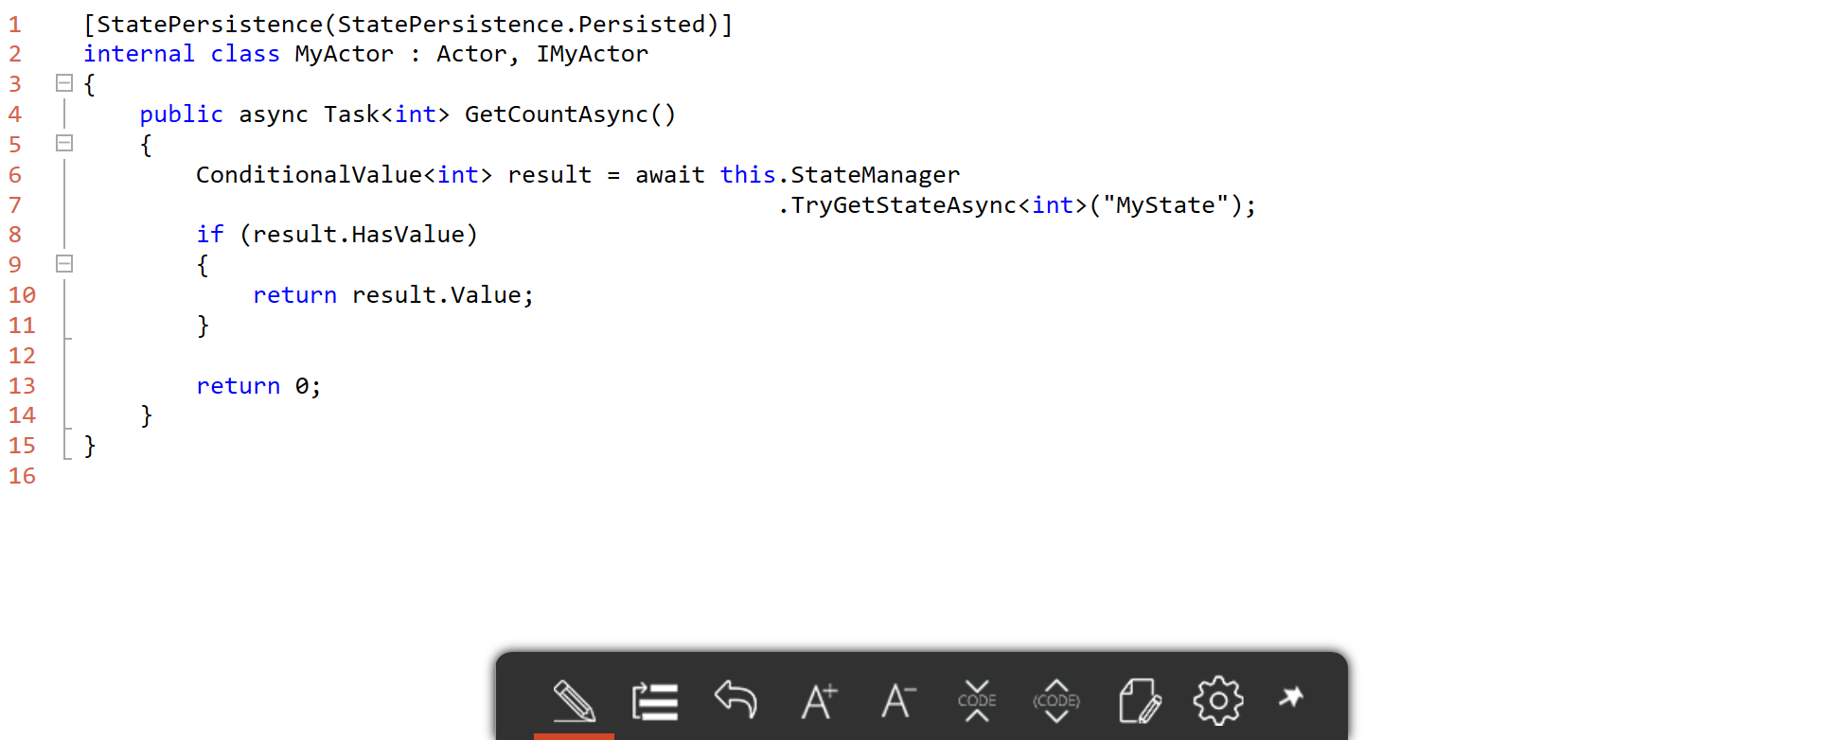
Service fabric – Actor – Reading state

Slide 28
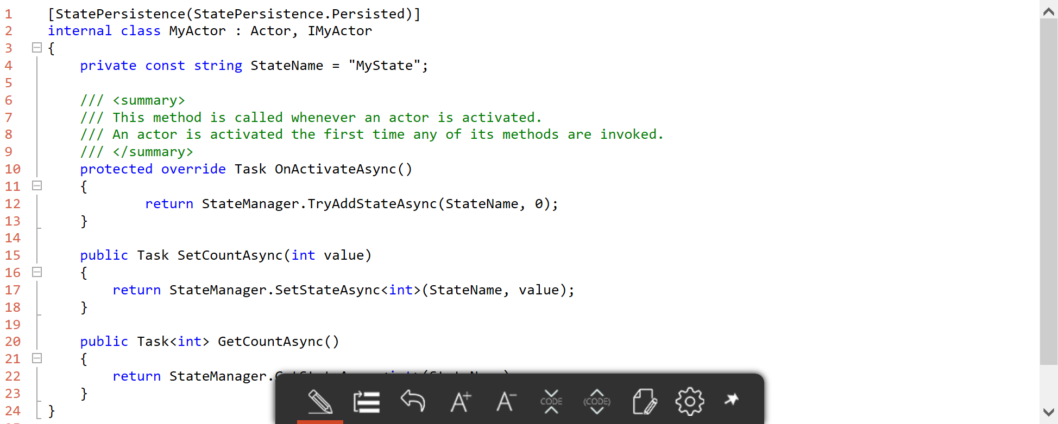
Service fabric – Actor – Initialization

Slide 29
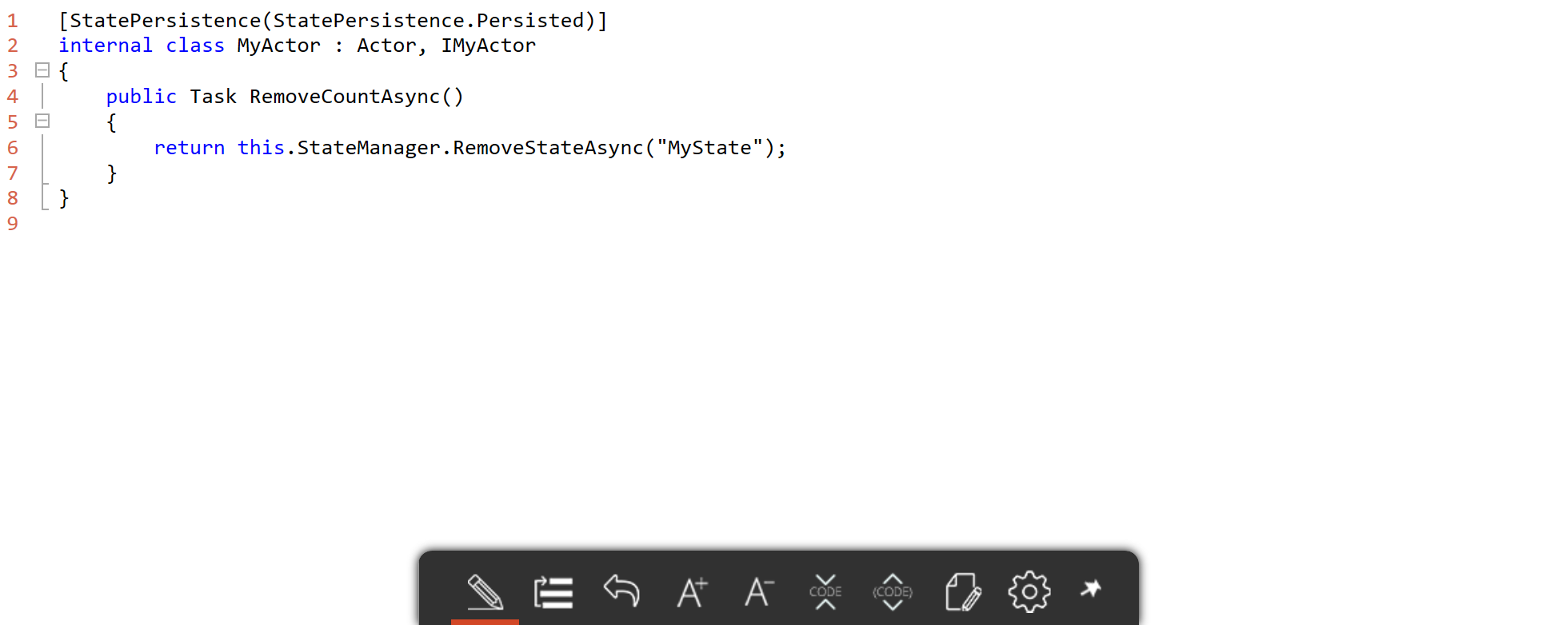
Service fabric – Actor – Removing state

Slide 30
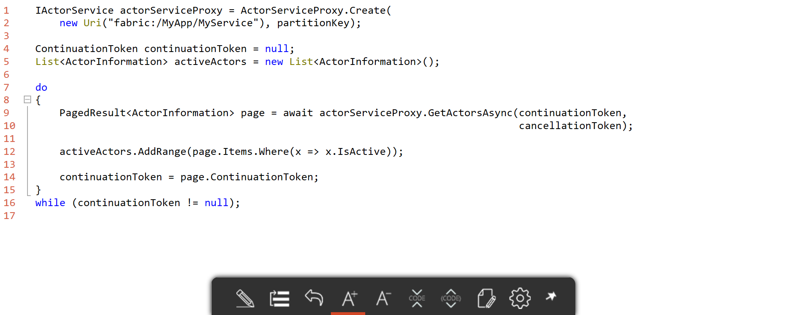
Service fabric – Actor – enumeration

Slide 31
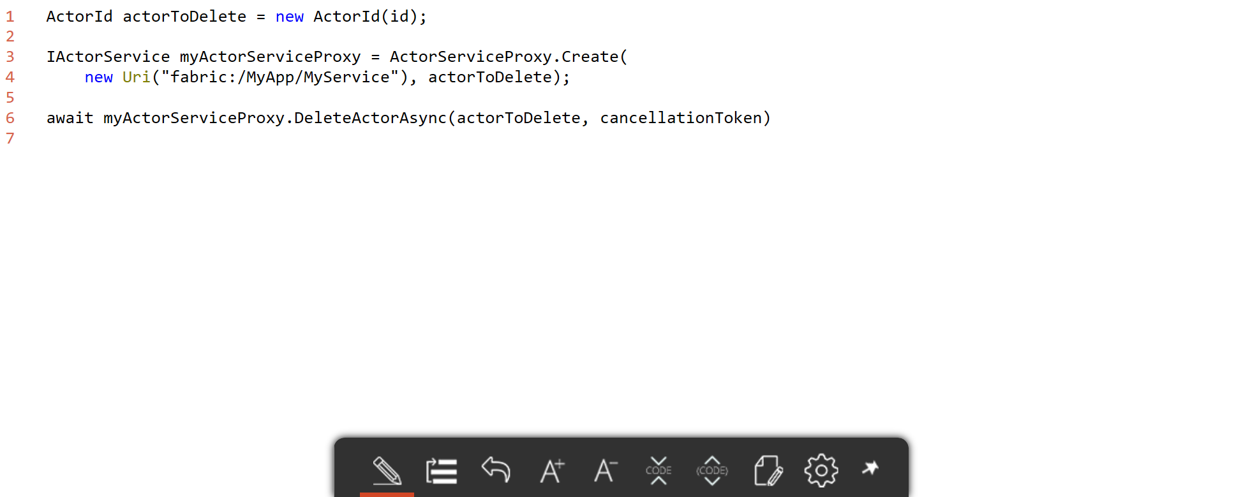
Service fabric – Actor – Deleting

Slide 32
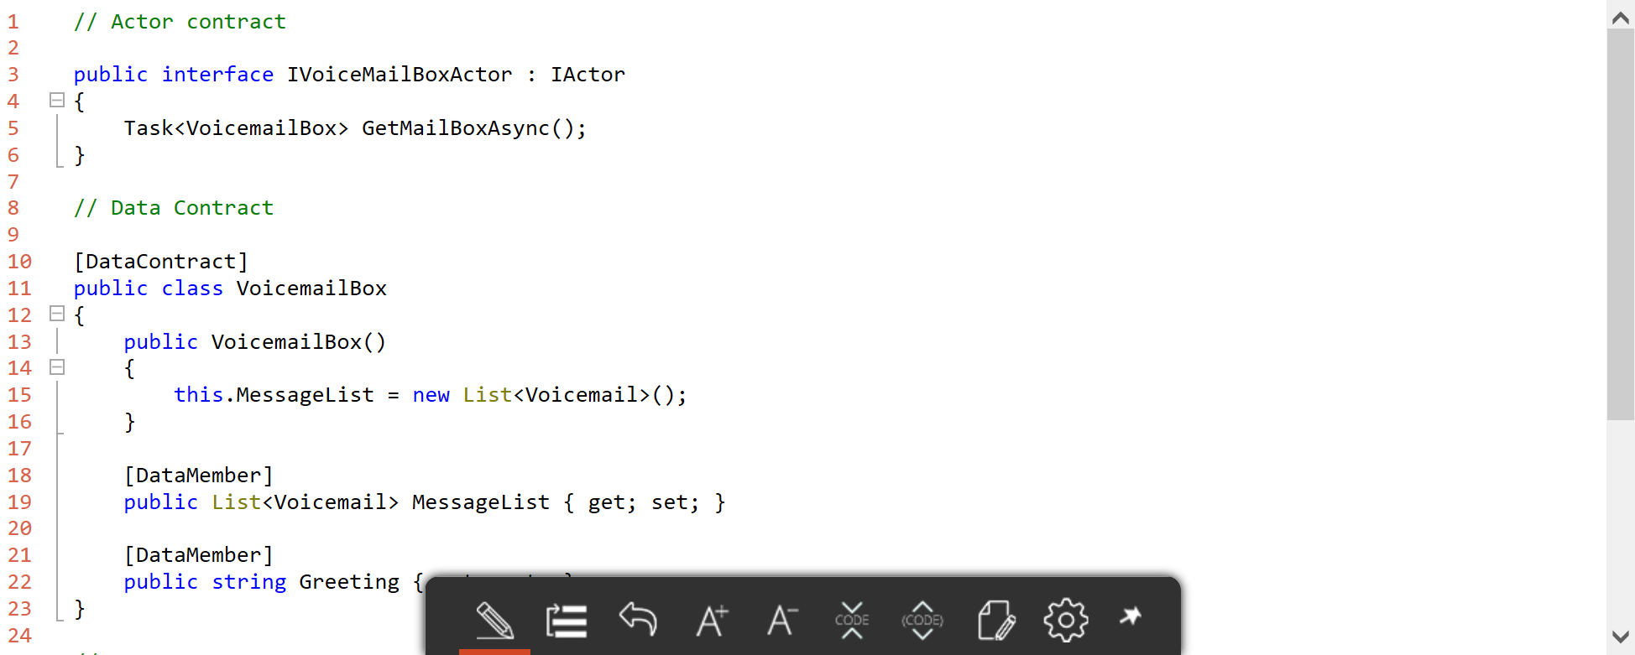
Service fabric – Actor – custom data types

Slide 33
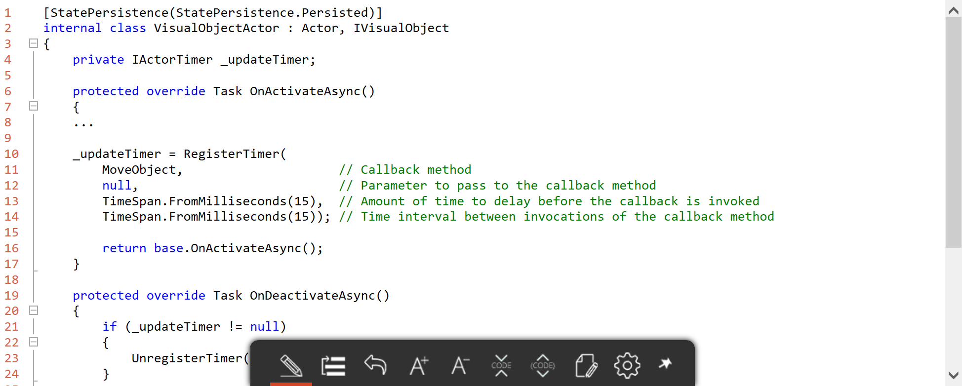
Service fabric – Actor – timers

Slide 34
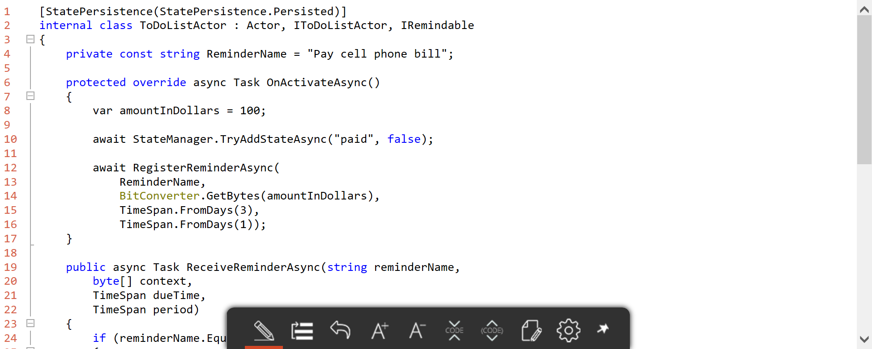
Service fabric – Actor – reminders

Slide 35
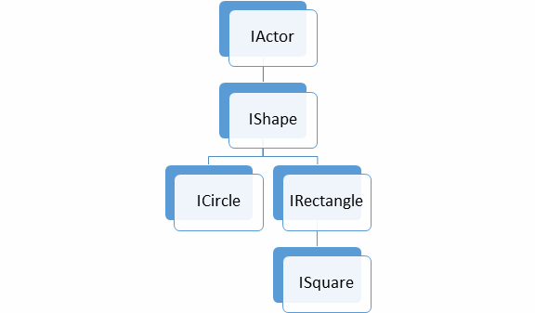
Service fabric – Actor – polymorphism

Slide 36
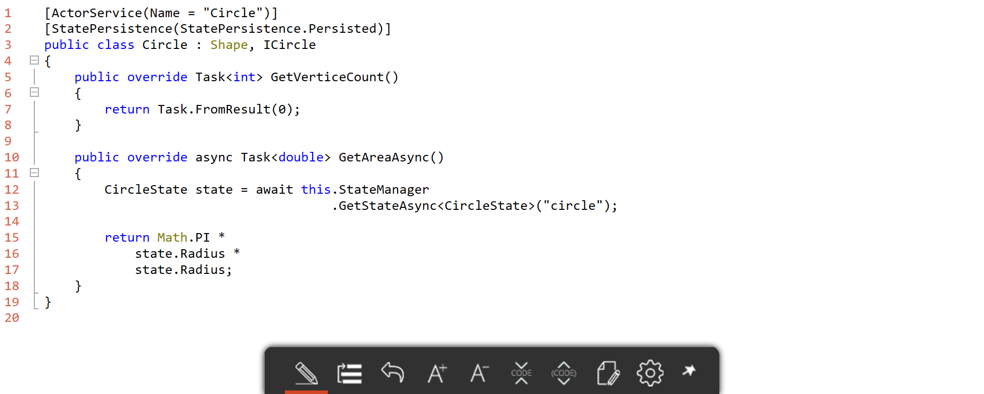
Service fabric – Actor – polymorphism

Slide 37
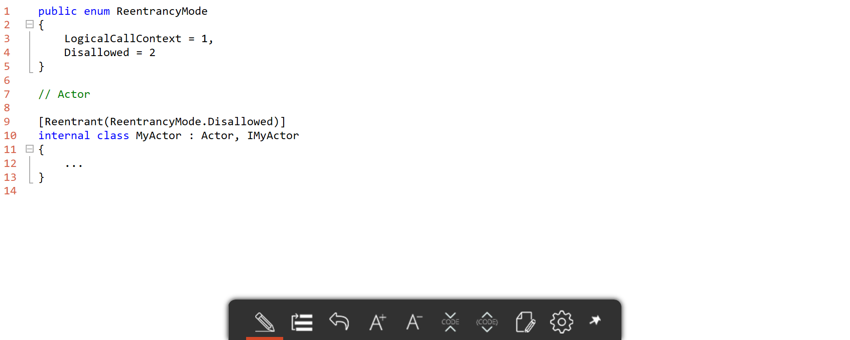
Service fabric – Actor – reentrancy

Slide 38
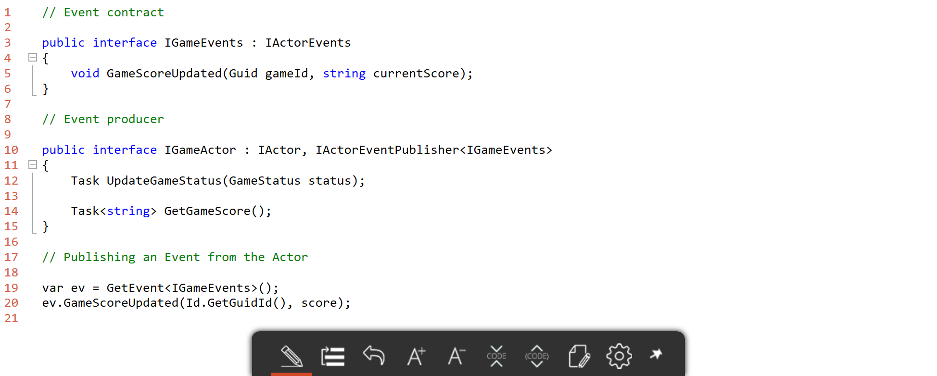
Service fabric – Actor – EVENT Producer

Slide 39
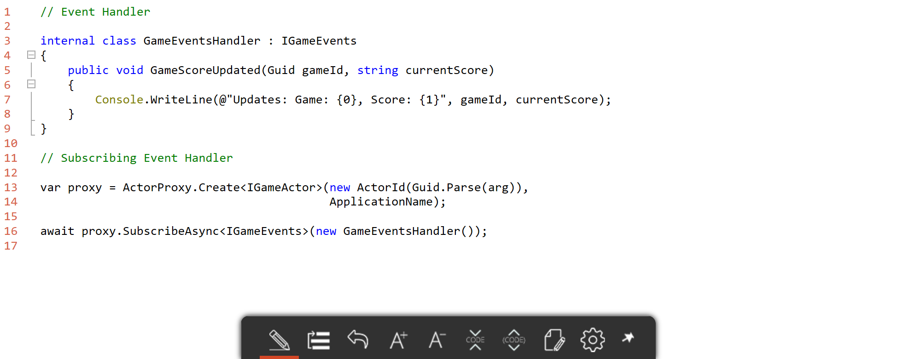
Service fabric – Actor – EVENT subscriber

Slide 40
Service Fabric – Reliable Actors
Do not use Reliable Actors when
You need distributed transactions
You want to control concurrency, partitioning and communication
If you need reliable collections

Slide 41
Service Fabric – Reliable Actor failover
Types of reconfiguration
Primary failover
Removing a failed secondary
Adding recovered replica
Building a new secondary
Replica States
None
Idle Secondary
Active Secondary
Primary
X
Failed
P
S
P
B
S
X
S
Failed
S
S
Must be safe in the presence of cascading failures

Slide 42
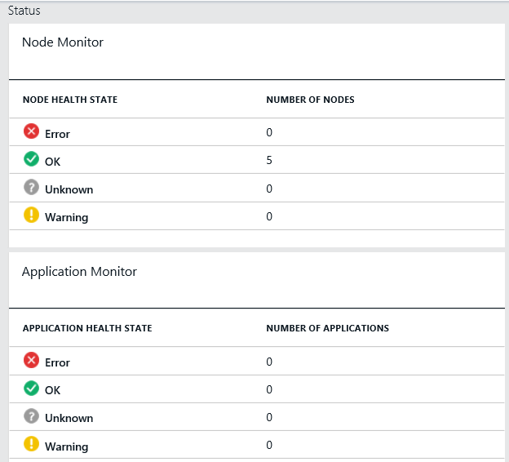
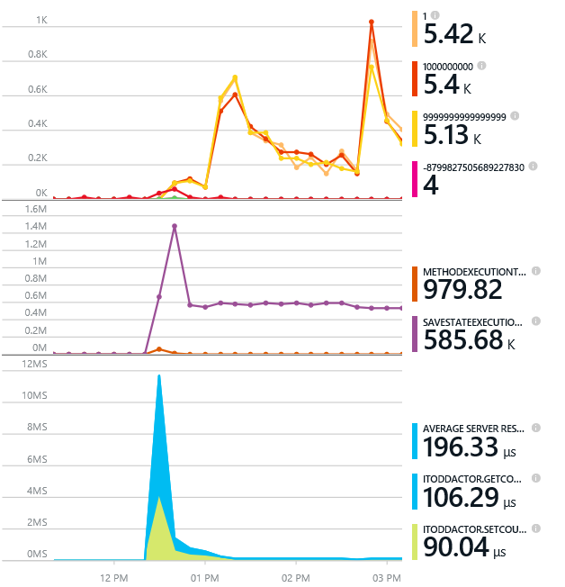
Monitoring your Services
Health status monitoring
Built-in health status for cluster and services
Flexible and extensible health store for custom app health reporting
Allows continuous monitoring for real-time alerting on problems in production
Performance and stress response
Rich built-in metrics for Actors and Services programming models
Easy to add custom application performance metrics

Slide 43
Diagnostics and Troubleshooting
Detailed System Optics
Repair suggestions. Examples: Slow RunAsync cancellations, RunAsync failures
All important events logged. Examples: App creation, deploy and upgrade records. All Actor method calls.
Custom Application Tracing
ETW == Fast Industry Standard Logging Technology
Works across environments. Same tracing code runs on devbox and also on production clusters on Azure.
Easy to add and system appends all the needed metadata such as node, app, service, and partition.
Choice of Tools
Visual Studio Diagnostics Events Viewer
Windows Event Viewer
Windows Azure Diagnostics + Operational Insights
Easy to plug in your preferred tools: Kibana, Elasticsearch and more

Slide 44
Service fabric – Actor – Scenarios
Highly available services
Scalable services
Computation on nonstatic data
Source: https://azure.microsoft.com/en-us/documentation/articles/service-fabric-application-scenarios/

Slide 45
Service fabric – Actor – Scenarios
Session-based interactive applications
Distributed graph processing
Data analytics and workflows
Source: https://azure.microsoft.com/en-us/documentation/articles/service-fabric-application-scenarios/

Slide 46
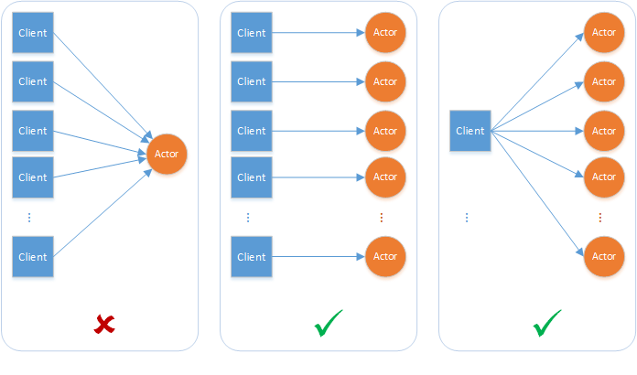
Service fabric – Actor – Patterns

Slide 47
Service fabric – Actor – Patterns
GRASP – General Responsibility Assignment Software Principles
https://en.wikipedia.org/wiki/GRASP_(object-oriented_design)
"Gang of Four“ Design Patterns
https://en.wikipedia.org/wiki/Design_Patterns
SOLID
https://en.wikipedia.org/wiki/SOLID_(object-oriented_design)
single responsibility
open-closed
Liskov substitution
interface segregation
dependency inversion

Slide 48
Service fabric Cloud Design Patterns
Idempotence is the property of certain operations in mathematics and computer science, that can be applied multiple times without changing the result beyond the initial application. The concept of idempotence arises in a number of places in abstract algebra and functional programming.
Idempotence https://en.wikipedia.org/wiki/Idempotence

Slide 49
Service fabric Cloud Design Patterns
Circuit Breaker Pattern
https://msdn.microsoft.com/en-us/library/dn589784.aspx
Gatekeeper Pattern
https://msdn.microsoft.com/en-us/library/dn589793.aspx
Index Table Pattern
https://msdn.microsoft.com/en-us/library/dn589791.aspx
Source
https://msdn.microsoft.com/en-us/library/dn568099.aspx

Slide 50
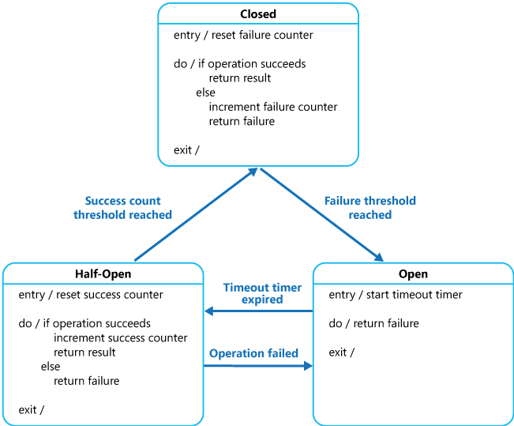
Service fabric Cloud Design Patterns
Circuit Breaker Pattern
https://msdn.microsoft.com/en-us/library/dn589784.aspx

Slide 51
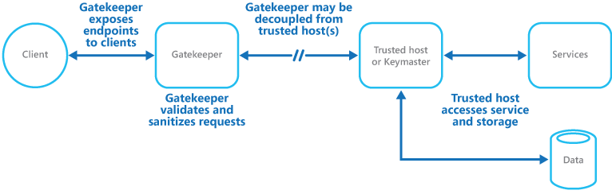
Service fabric Cloud Design Patterns
Gatekeeper Pattern
https://msdn.microsoft.com/en-us/library/dn589793.aspx

Slide 52
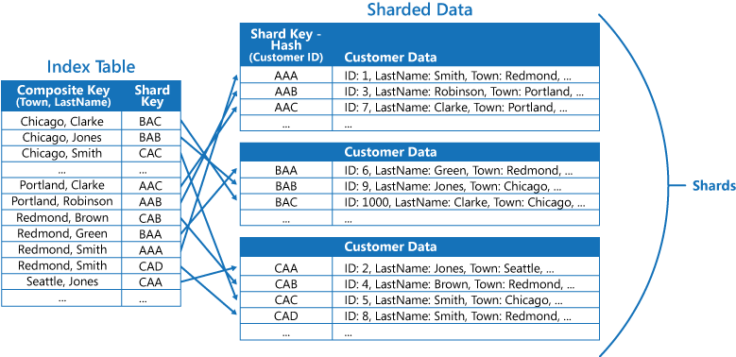
Service fabric Cloud Design Patterns
Index Table Pattern
https://msdn.microsoft.com/en-us/library/dn589791.aspx

Slide 53
Service fabric Cloud Design Patterns
Materialized View Pattern
https://msdn.microsoft.com/en-us/library/dn589782.aspx
Pipes and Filters Pattern
https://msdn.microsoft.com/en-us/library/dn568100.aspx
Sharding Pattern
https://msdn.microsoft.com/en-us/library/dn589797.aspx
Source
https://msdn.microsoft.com/en-us/library/dn568099.aspx

Slide 54
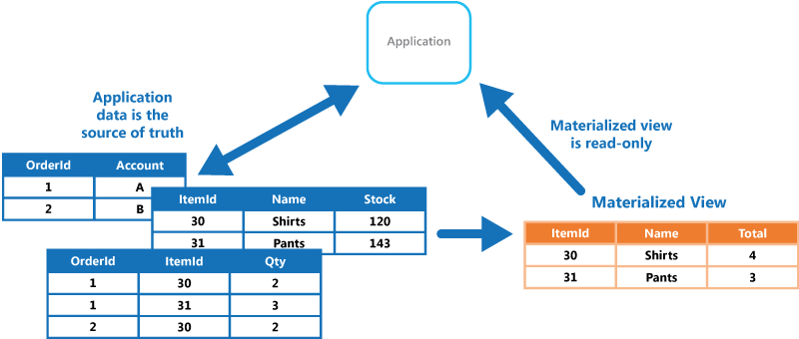
Service fabric Cloud Design Patterns
Materialized View Pattern
https://msdn.microsoft.com/en-us/library/dn589782.aspx

Slide 55
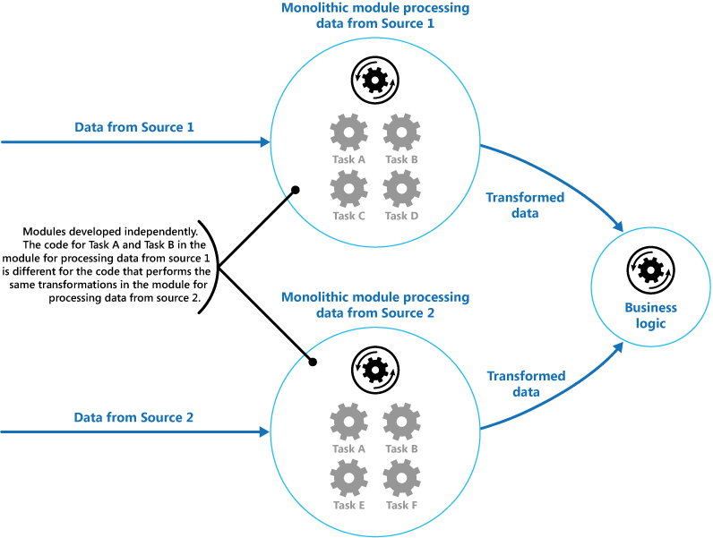
Service fabric Cloud Design Patterns
Pipes and Filters Pattern https://msdn.microsoft.com/en-us/library/dn568100.aspx

Slide 56
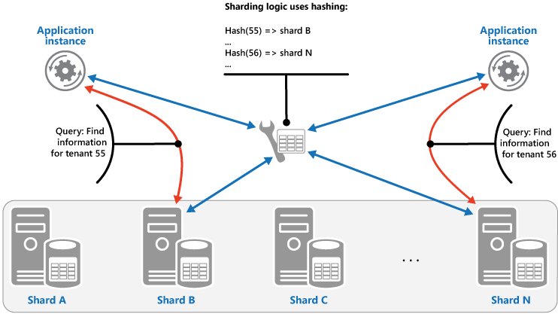
Service fabric Cloud Design Patterns
Sharding Pattern
https://msdn.microsoft.com/en-us/library/dn589797.aspx

Slide 57
Service fabric Cloud Design Patterns
Cache-Aside Pattern
https://msdn.microsoft.com/en-us/library/dn589799.aspx
Compute Resource Consolidation Pattern
https://msdn.microsoft.com/en-us/library/dn589778.aspx
Priority Queue Pattern
https://msdn.microsoft.com/en-us/library/dn589794.aspx
Source
https://msdn.microsoft.com/en-us/library/dn568099.aspx

Slide 58
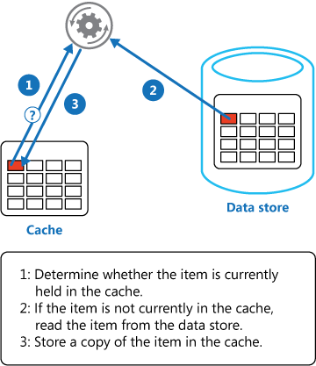
Service fabric Cloud Design Patterns
Cache-Aside Pattern
https://msdn.microsoft.com/en-us/library/dn589799.aspx

Slide 59
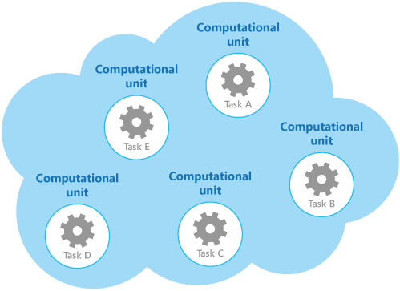
Service fabric Cloud Design Patterns
Compute Resource Consolidation Pattern
https://msdn.microsoft.com/en-us/library/dn589778.aspx

Slide 60
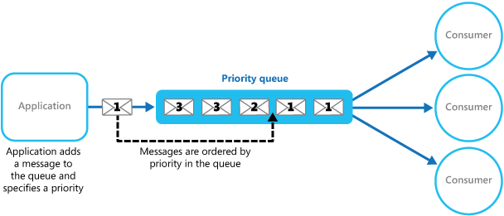
Service fabric Cloud Design Patterns
Priority Queue Pattern
https://msdn.microsoft.com/en-us/library/dn589794.aspx

Slide 61
Service fabric Cloud Design Patterns
Throttling Pattern
https://msdn.microsoft.com/en-us/library/dn589798.aspx
Idempotence
https://en.wikipedia.org/wiki/Idempotence
Source
https://msdn.microsoft.com/en-us/library/dn568099.aspx

Slide 62
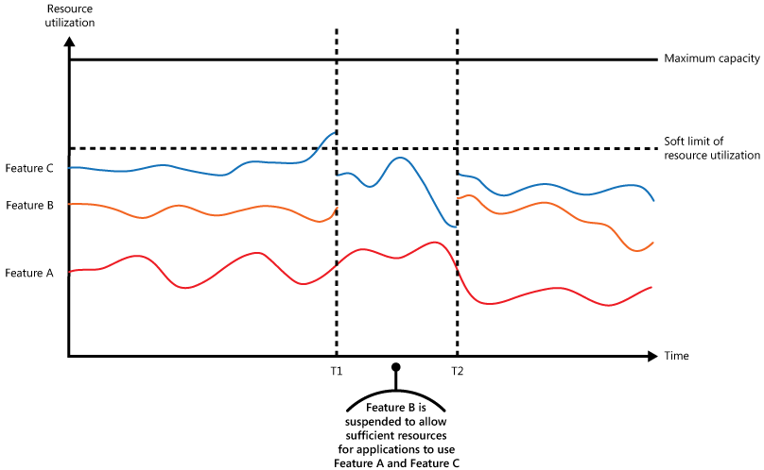
Service fabric Cloud Design Patterns
Throttling Pattern
https://msdn.microsoft.com/en-us/library/dn589798.aspx

Slide 63
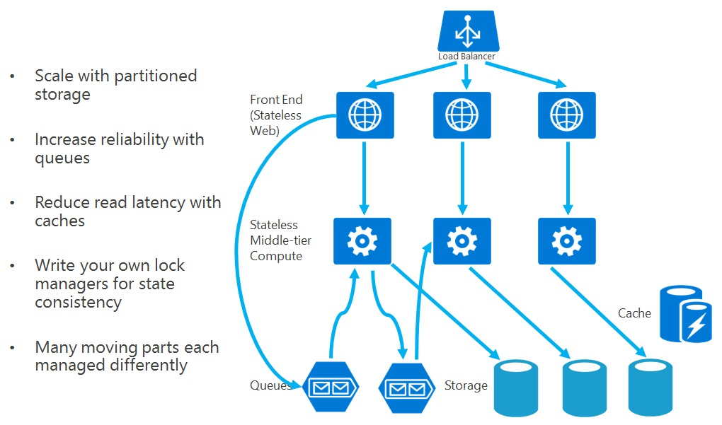
Service fabric – Actor – Patterns

Slide 64
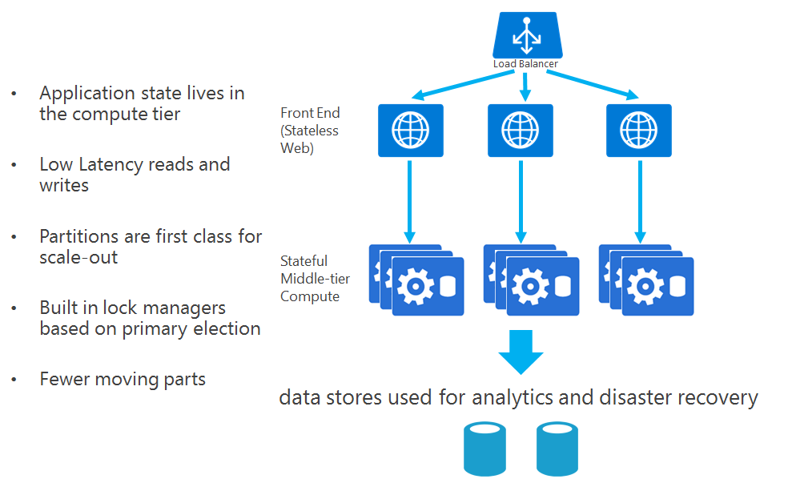
Service fabric – Actor – Patterns

Slide 65
Qestions & Answers
Get in Touch
Service Fabric Resources
Twitter: @Brisebois
Blog: http://bit.ly/blog-alex
Email: alexandre.brisebois@microsoft.com
Documentation: http://aka.ms/servicefabric
SDK: http://aka.ms/servicefabricSDK
QnA Demo Code: http://bit.ly/git-qna-demo

